Slide 1
Hardware Opportunities
in the Machine Learning Lifecycle
Joseph E. Gonzalez
Co-director of the RISE Lab jegonzal@cs.berkeley.edu

Slide 2

Get the latest slides and links to literature
https://tinyurl.com/isscc-lifecycle

Slide 3
About Me
Co-director of the RISE Lab
Co-founder of Turi Inc.
Member of the Apache Spark PMC
Research
Artificial Intelligence
Data Science
Distributed Data Systems
Graph Processing Systems
I don’t study processor architecture
But I probably should …

Slide 4
Outline
History and the Co-evolution of Hardware and AI
The Feedback Cycle driving the 3rd wave of AI
Machine Learning is not a single workload
Stages of the Machine Learning Lifecycle
Security and machine learning
Along the way, I will talk about some of the research in my group addressing interesting aspects of the lifecycle.

Slide 5
Hardware and the History of AI
1950 to 1974: Birth of AI
1951 Marvin Minsky builds first neural network hardware (SNARC)
1974 to 1980: First AI Winter
Limited processing power and data
1980 to 1987: Second Wave of AI
XCON (AI for hardware configuration) for DEC → boom in AI hardware companies
1987 to 1993: Second AI Winter
Brittle AI and the collapse of the AI Hardware Market
1993 to 2011: AI → Machine Learning
Confluence of ideas + Compute + Big Data → AI starts to really work
2011 to 2019: Third Wave (Deep Learning)
Compute + data + abstractions → feedback cycle
Notes:
Over 300 AI companies had shutdown, gone bankrupt, or been acquired by the end of 1993, effectively ending the first commercial wave of AI

Slide 6
Compute
Feedback
Cycle
Abstractions
Data & Models

Slide 7
Data & Models
Feedback
Cycle
Narrow Waste
Abstractions
Compute

Slide 8
Abstractions are Enabling Innovation
Much of machine learning before 2010
Research focused on machine learning algorithms
Programs written using high-level imperative languages
Matlab/R/C++/Java
Big abstractions: linear algebra, map-reduce, graph systems
Today:
Research focused on model design
Models written in high-level DSLs
TensorFlow/Pytorch
Big abstractions: tensor operations, loss minimization, linear algebra, …
Models written in TensorFlow can now run on hardware that didn’t exist when the models were created.

Slide 9
How do we make hardware for
Machine learning?
Machine learning is not a single application.

Slide 10
Machine learning is
multiple applications with different requirements.
Machine Learning Lifecycle

Slide 11
Identifying potential sources of data
Joining data from multiple sources
Addressing missing values and outliers
Plotting trends to identify anomalies

Slide 12
Building informative features functions
Designing new model architectures
Tuning training algos.
Validating prediction accuracy

Slide 13
Frameworks

Slide 14
Model Development → Hardware
Need to test multiple designs and hyperparameters quickly
May be better to run many parallel experiments than one experiment faster
Debug heavy → sources of error → data, hyperparams., & model
System should not be a source of error
Avoid cutting corners (e.g., quantization, async) for increased performance
Unless you can make a case for stable convergence …
Data preparation is often a bottleneck
Opportunity for data tooling
Accelerate data transformation and augmentation
Emerging Trends
Attention Models and Graph Neural Networks: reduced locality, sparsity
Dynamic Networks: gating, cascades, mixtures, …
Increased emphasis on DNN features and Fine-Tuning
Reuse of common architectures and weights

Slide 15
Dynamic Networks for fast and accurate inference
IDK Cascades: Using the fastest model possible [UAI’18]
SkipNet: dynamic execution within a model [ECCV’18]
Skipped
Blocks
Query
Conv
Prediction
Conv
Conv
Conv
Gate
Conv
Conv
Gate
Conv
FC

Slide 16
for fast and accurate inference
Dynamic Networks
IDK Cascades: Using the fastest model possible [UAI’18]
Simple Model
I Don’t
Know
Accurate Model
Query
Fast
Slow
Prediction
Prediction
SkipNet: dynamic execution within a model [ECCV’18]
Skipped
Blocks
Query
Conv
Prediction
Conv
Conv
Conv
Gate
Conv
Conv
Gate
Conv
FC
Large Reductions in FLOPS
Skip more layers on clear images
Easy Images Skip Many Layers
Hard Images
Skip Few Layers

Slide 17

Task Aware Feature Embeddings [CVPR’19]
Feature
Network
FF Net
FF Net
FF Net
Baby
Task Aware
Meta-Learner
Params
x
Params
x
Params
x
More accurate and efficient than existing
dynamic pruning
networks
Emb.
Network
FC Layer
FC Layer
FC Layer

Slide 18
Task Aware Feature Embeddings [CVPR’19]
Dynamic Networks
Feature
Network
FF Net
FF Net
FF Net
Yes
Task Aware
Meta-Learner
Params
x
Params
x
Params
x
Task Description:
“Smiling
Baby”
Emb.
Network
4 - 15% improvement on attribute-object tasks
FC Layer
FC Layer
FC Layer

Slide 19
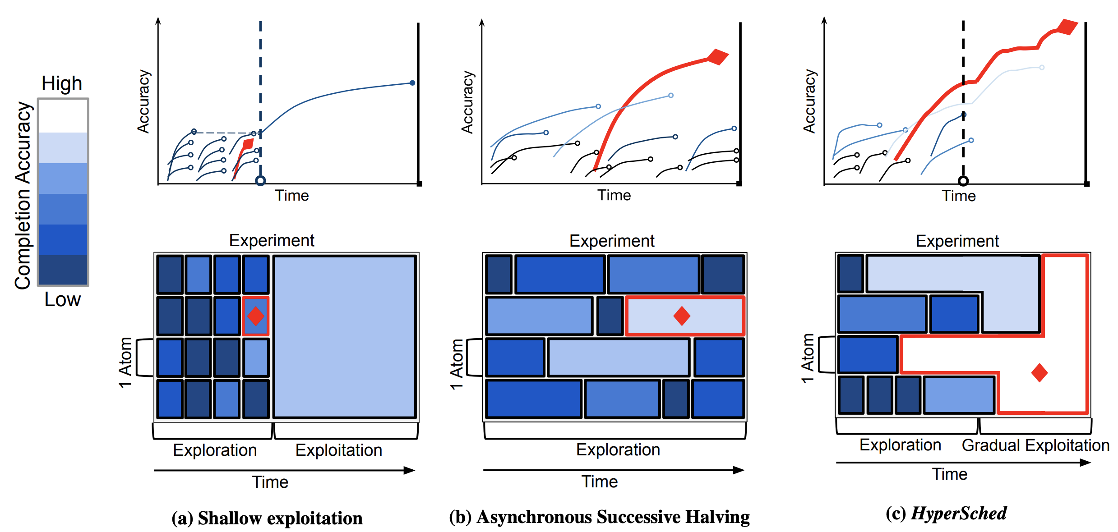
HyperSched [SOCC’19]
Dynamically allocating parallel resources to parallel experiments.
Shallow Exploration
Successive Halving
HyperSched
GPUs

Slide 20
HyperSched [SOCC’19]
Dynamically allocating parallel resources to parallel experiments.
Shallow Exploration
Successive Halving
HyperSched
GPUs

Slide 21
HyperSched [SOCC’19]
Dynamically allocating parallel resources to parallel experiments.
Shallow Exploration
Successive Halving
HyperSched
GPUs

Slide 22
What is the output of
Reports & Dashboards
(insights …)
Trained Model
Bad Idea

Slide 23
What is the output of
Why is it a Bad Idea to directly produce trained models from model development?
With just a trained model we are unable to
retrain models with new data
track data and code for debugging
capture dependencies for deployment
audit training for compliance (e.g., GDPR)
Trained Models

Slide 24
What is the output of
Reports & Dashboards
(insights …)
Trained Models
Bad Idea

Slide 25
What is the output of
Reports & Dashboards
(insights …)
Training Pipelines

Slide 26
Training Pipelines Capture the Code and Data Dependencies
Description of how to train the model from data sources
Training Pipelines
Trained
Models
Training Data
Software Engineering
Analogy
Training Pipelines → Code
Trained Models → Binaries

Slide 27
What is the output of
Reports & Dashboards
(insights …)
Training Pipelines

Slide 28
What is the output of

Slide 29
Training models at scale on live data
Retraining on new data
Automatically validate prediction accuracy
Manage model versioning
Requires minimal expertise in machine learning

Slide 30
Systems
Workflow Management:
Apache
Airflow
Scalable Training:

Slide 31
Model Training → Hardware
Fewer models to train → need distributed training of individual models
Often train with more data
Larger models and mini-batch sizes
Need larger on-device memory
Counter trends → reversable networks, optimal checkpointing, …
Models and hyperparameters are vetted → focus on system optimizations
Can tolerate some system error (quantization and async.)
Need adequate stability to meet deadlines
Data preparation is still potentially an issue (as with model dev.)
Need to deal with composition of multiple models

Slide 32
Do Bigger Models Train Faster?
(Preliminary unpublished work.)
Studying pre-training of large Transformer Models for NLP task (e.g., BERT)
More Resilient to Lossy Compression

Slide 33
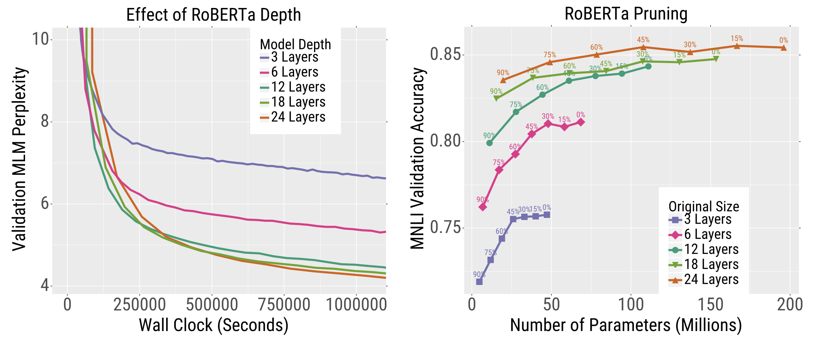
Do Bigger Models Train Faster?
(Preliminary unpublished work.)
Studying pre-training of large Transformer Models for NLP task (e.g., BERT)
Deeper Models Reduce Error Faster
More Resilient to Lossy Compression

Slide 34
Do Bigger Models Train Faster?
(Preliminary unpublished work.)
Studying pre-training of large Transformer Models for NLP task (e.g., BERT)
Deeper Models Reduce Error Faster
More Resilient to Lossy Compression

Slide 35
Scaling deep learning training beyond the GPU memory wall.
[MLSys 2020]

Slide 36
How do we train models both efficiently
and beyond memory limits?
At a per-GPU level, recent state-of-the-art models have hit a memory capacity wall.
Problem:
RAM usage
per-GPU
Limited GPU memory is slowing progress in new deep learning models!
Notes:
If we zoom in on a single GPU, we see that memory is a key limiting factor. As models continue to grow, they are encroaching on the memory capacity limits of GPUs today. Worryingly, researchers cite limited memory as a reason for making architectural compromises. Limits in GPU memory are slowing progress in the state-of-the-art in model training.

Slide 37
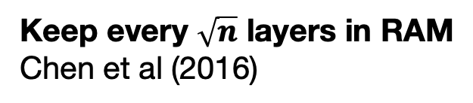
Efficiently trade-off RAM and Compute
RAM
Keep all layers in RAM
Keep every $\sqrt{n}$ layers in RAM
Chen et al (2016)
Checkmate explores optimal trade-off
5x larger models w/ 2x cost
Keep no layers in RAM
Compute
Notes:
More concretely, this work explores a tradeoff between memory and compute during deep learning. We’ll explore a few endpoints of this tradeoff space. Ultimately, Checkmate explores the optimal tradeoff between memory and CPU. We will show how Checkmate enables training 5x larger models.

Slide 38
RAM-hungry backpropagation policy
Keep all layers in RAM
RAM
Keep all layers in RAM
Keep every $\sqrt{n}$ layers in RAM
Chen et al (2016)
Keep no layers in RAM
Compute
Notes:
Let’s examine the current practice at one end of this tradeoff. Frameworks such as PyTorch and TensorFlow retain all activations in memory today.

Slide 39
RAM-hungry backpropagation policy
Keep all layers in RAM
RAM
used
Forward Pass
∇E
A
B
C
D
E
E
Label
D
Loss
∇A
∇B
∇C
∇D
∇E
C
Backward Pass
B
A
Time
Notes:
Deep learning is divided into two key phases, a forward pass and a backward pass. The backwards pass comptues gradients that iteratively optimize parameters. Let me demonstrate why the backwards pass is so memory intensive. Since we need to retain all activations, memory usage linearly increases during the forward pass.

Slide 40
RAM-hungry backpropagation policy
Keep all layers in RAM
RAM
used
Forward Pass
∇E
∇D
A
B
C
D
E
E
Label
E
D
Loss
∇A
∇B
∇C
∇D
∇E
C
Backward Pass
B
A
Time
Notes:
Finally, during the backward pass, we can free unused activations, but the peak memory usage is quite high.

Slide 41
RAM-hungry backpropagation policy
Keep all layers in RAM
RAM
used
Forward Pass
∇E
∇D
∇C
E
D
A
B
C
D
E
E
Label
D
Loss
∇A
∇B
∇C
∇D
∇E
C
Backward Pass
B
A
Time
Notes:
Finally, during the backward pass, we can free unused activations, but the peak memory usage is quite high.

Slide 42
RAM-hungry backpropagation policy
Keep all layers in RAM
RAM
used
Peak RAM
C
Forward Pass
∇E
∇D
∇C
∇B
∇A
D
A
B
C
D
E
E
B
Label
D
Loss
E
∇A
∇B
∇C
∇D
∇E
C
Backward Pass
B
A
Time
Notes:
Finally, during the backward pass, we can free unused activations, but the peak memory usage is quite high.

Slide 43
Compute-hungry backpropagation policy
Recompute all layers as needed, storing none
RAM
Keep all layers in RAM
Keep every $\sqrt{n}$ layers in RAM
Chen et al (2016)
Recompute all layers
Compute
Notes:
At the other end of this design spectrum we explore design point where we store as little data as possible in on-chip memory.

Slide 44
Compute-hungry backpropagation policy
Recompute all layers
RAM
used
Peak RAM (no recomputation)
Forward Pass
A
B
C
D
E
Label
D
Loss
∇A
∇B
∇C
∇D
∇E
C
Backward Pass
B
A
Time
How can we use less memory?
Free early & recompute
Notes:
So returning to our prior example, because we have begun to train and we realized we are going to run out of memory on the accelerator. How can we use less memory. One key insight is to free some nodes early. And then re compute some layers during the backwards pass.

Slide 45
Compute-hungry backpropagation policy
Recompute all layers
RAM
used
Peak RAM (no recomputation)
Forward Pass
A
B
C
D
E
Label
Loss
∇A
∇B
∇C
∇D
∇E
C
D
Backward Pass
B
B
A
C
A
Time
How can we use less memory?
Free early & recompute
Notes:
We free A, B, C.

Slide 46
Compute-hungry backpropagation policy
Recompute all layers
RAM
used
Peak RAM (no recomputation)
Forward Pass
A
B
C
D
E
Label
Loss
∇A
∇B
∇C
∇D
∇E
C
D
E
∇E
∇D
Backward Pass
B
B
A
C
A
Time
How can we use less memory?
Free early & recompute
Notes:
However, we cannot compute the gradient for C. We must recompute A, B and C during the backward pass.

Slide 47
Compute-hungry backpropagation policy
Recompute all layers
RAM
used
Peak RAM (no recomputation)
Forward Pass
A
B
C
D
E
Label
Loss
∇A
∇B
∇C
∇D
∇E
C
D
E
∇E
∇D
A
B
C
Backward Pass
B
B
A
C
A
Time
How can we use less memory?
Free early & recompute
Notes:
However, we cannot compute the gradient for C. We must recompute A, B and C during the backward pass.

Slide 48
Compute-hungry backpropagation policy
Recompute all layers
RAM
used
Peak RAM (no recomputation)
Forward Pass
A
B
C
D
E
Label
Peak RAM
Loss
∇A
∇B
∇C
∇D
∇E
C
D
E
∇E
∇D
A
B
C
∇C
…
Backward Pass
B
B
A
C
A
Time
How can we use less memory?
Free early & recompute
Notes:
This substantially reduces memory consumption, but at a great increase in runtime.

Slide 49
Prior heuristic as an intermediate trade-off point
RAM
Keep all layers in RAM
Keep every $\sqrt{n}$ layers in RAM
Chen et al (2016)
Recompute all layers
Compute
Notes:
There has been some prior work that has explored intermediate design points in this space time trade off, most notably Chen et al’s work in 2016 where they propose a simple heuristic of checkpointing every square root n’th node.

Slide 50
How to trade-off RAM for compute optimally?
Challenges:
RAM
1. Variable runtime per layer
Checkpoint
every node
2. Variable RAM usage per layer
Recompute all layers
3. Real DNNs are non-linear
Compute
Notes:
In our work, we want to answer the question of how to optimally trade off memory for compute during deep learning training. We design our solution to address three practical issues that have limited adoption of recomputation with real architectures.

Slide 51

Why do fixed heuristics perform poorly?
Latency is not constant between layers
10⁶x compute gap between biggest and smallest layer in VGG19
x10⁶

Slide 52
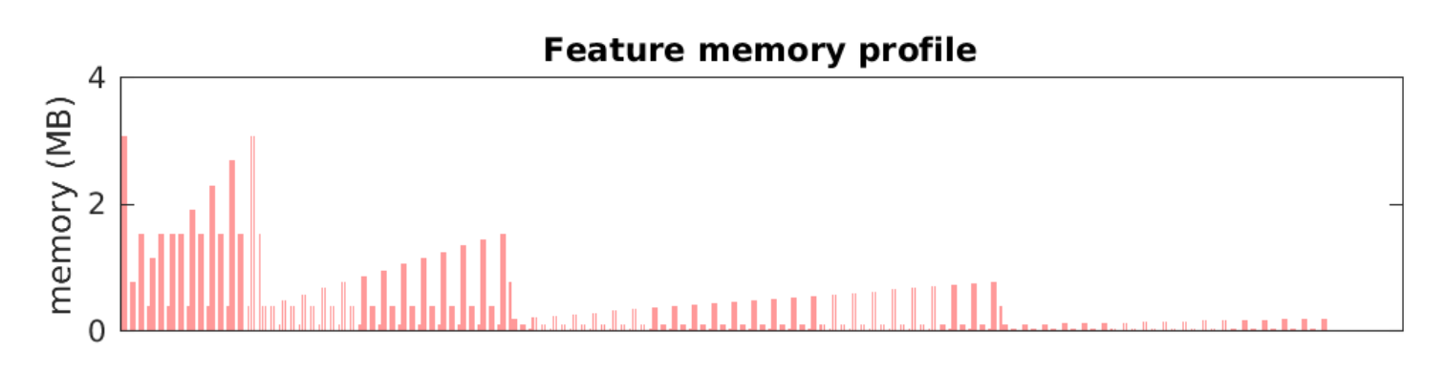
Why do fixed heuristics perform poorly?
2. Tensors are not all the same size
DenseNet-201 has large variability in activation sizes between layers
Feature memory profile
4 MB
x10³
2 MB
0 MB
Operation
Data from https://github.com/albanie/convnet-burden/blob/master/reports/densenet201.md

Slide 53

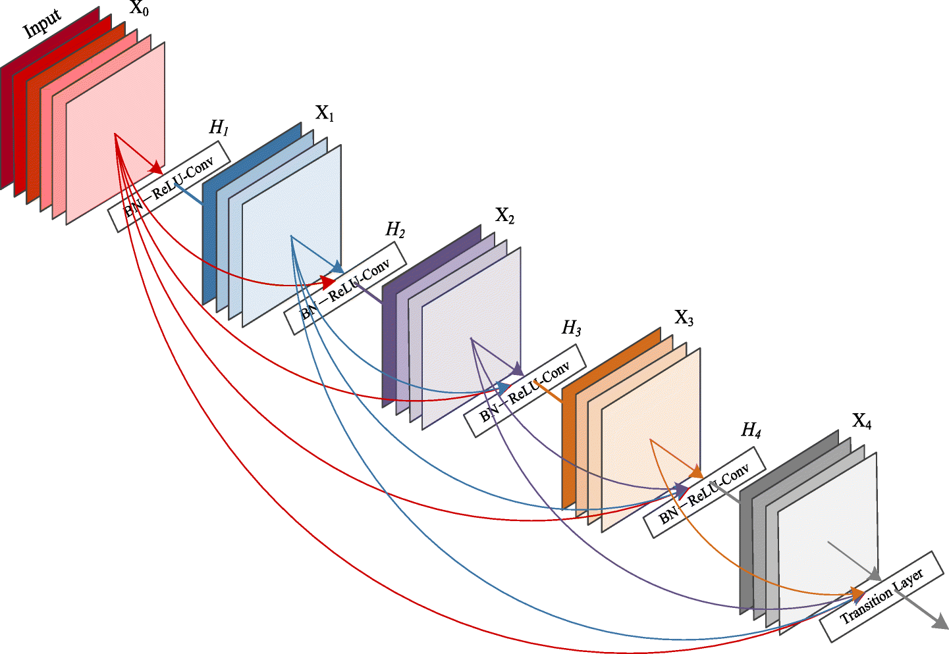
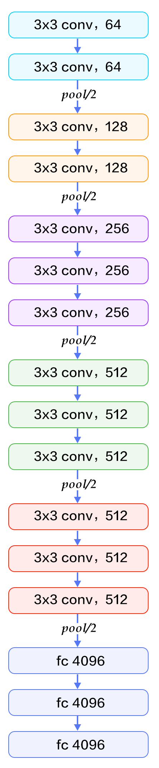
Why do fixed heuristics perform poorly?
3. Real DNN architectures are non-linear
U-Net: 11k citations
DenseNet: 7k citations

Slide 54

A system for optimal tensor rematerialization
Profile layers
Statically optimize graph once (10s to 1hr)
Train optimized graph for weeks
Checkmate composed of 3 parts:
Profiling: hardware/RAM aware schedules
Integer LP: enables finding optimal schedule
TF2.0 graph pass: support TPU, GPU, CPU
Solve integer LP
Rewrite TF2.0 graph
Notes:
In light of these challenges, we propose Checkmate, a system for optimal tensor rematerialization. Checkmate optimizes a graph statically once. This optimization is then amortized across many iterative training iterations over the span of weeks. Checkmate consists of three main parts:. We will focus on the second optimization phase in today’s talk. Please come to our poster tonight for more details.

Slide 55
Variance Reduction for Quantized Training
Jianfei Chen (Postdoc)
(Preliminary unpublished work.)
Input
Quantized weights, activations, and gradients
Studying uniform stochastic rounding
Prove gradient is unbiased
hardware support needed…
Consequence:
Quantization preserves “correctness” of SGD → Does affect convergence rate
Analyze Variance
1 less bit > 2x increase in stdev of gradient estimates
4x increase in batch size to recover convergence rates
Studying variance reduction mechanism
developing quantization preconditioners
Q
Weight
Linear
Q
Gradient
Q
Q
Nonlinearity
Gradient
Q
Weight
Q
Linear
Q
Gradient
Q
Output
Loss

Slide 56
Composition
Models are being composed to solve new problems
Cuteness Detector
Cute!

Slide 57
Composition
Models are being composed to solve new problems
Puppy
Detector
Yes
Cuteness Detector
Cute!
Ball Detector
Yes

Slide 58
Composition
Models are being composed to solve new problems
Puppy
Detector
Wrong but helpful…
Yes
Cuteness Detector
Still Correct
Cute!
Ball Detector
Yes
Notes:
composition

Slide 59
Composition
Models are being composed to solve new problems
Puppy
Detector
Wrong but helpful…
Yes
Cuteness Detector
Still Correct
Cute!
Ball Detector
Yes

Slide 60
Composition
Models are being composed to solve new problems
Puppy
Detector
Reasonable Improvement
No
Cuteness Detector
Not Cute!
Ball Detector
Degradation in accuracy
Yes
Notes:
fasdf

Slide 61
Composition
Models are being composed to solve new problems
Need to track composition and validate end-to-end accuracy.
Puppy
Detector
Reasonable Improvement
Need unit and integration testing for models.
No
Cuteness Detector
Not Cute!
Ball Detector
Degradation in accuracy
Yes
Notes:
fasdf

Slide 62
What is the output of

Slide 64
Focus of AI Hardware
Goal: make predictions in ~10ms under heavy load
Complicated by Deep Neural Networks ➔ New ML Algorithms and Systems

Slide 65
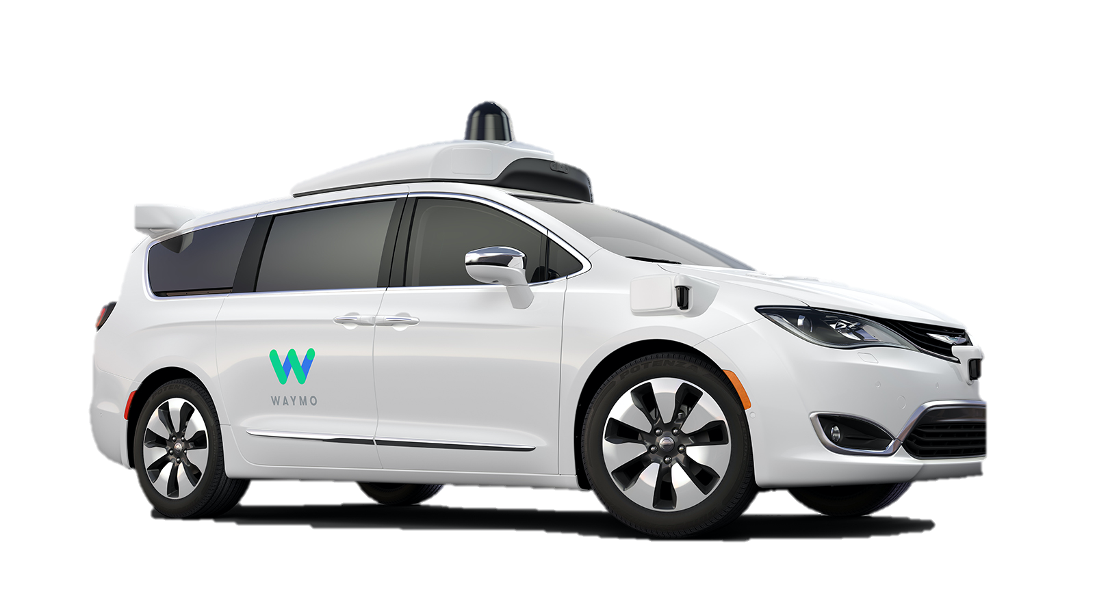
is multiple Applications.
The Cloud
The “Edge”
Mobile Devices

Slide 66
is multiple Applications.
The Cloud
The “Edge”
Mobile Devices
Throughput
Oriented
Latency Oriented
Variable Load
Predictable Load
Budget
Power
Energy

Slide 67
Basic Linear Models (Often High Dimensional)
Common for click prediction and text filter models (spam)
Query x encoded in sparse Bag-of-Words:
x = “The quick brown” = {(”brown”, 1), (”the”, 1), (“quick”, 1)}
Rendering a prediction:
θ is a large vector of weights for each possible word
or word combination (n-gram models) …
Focus on fast weight retrieval

Slide 68
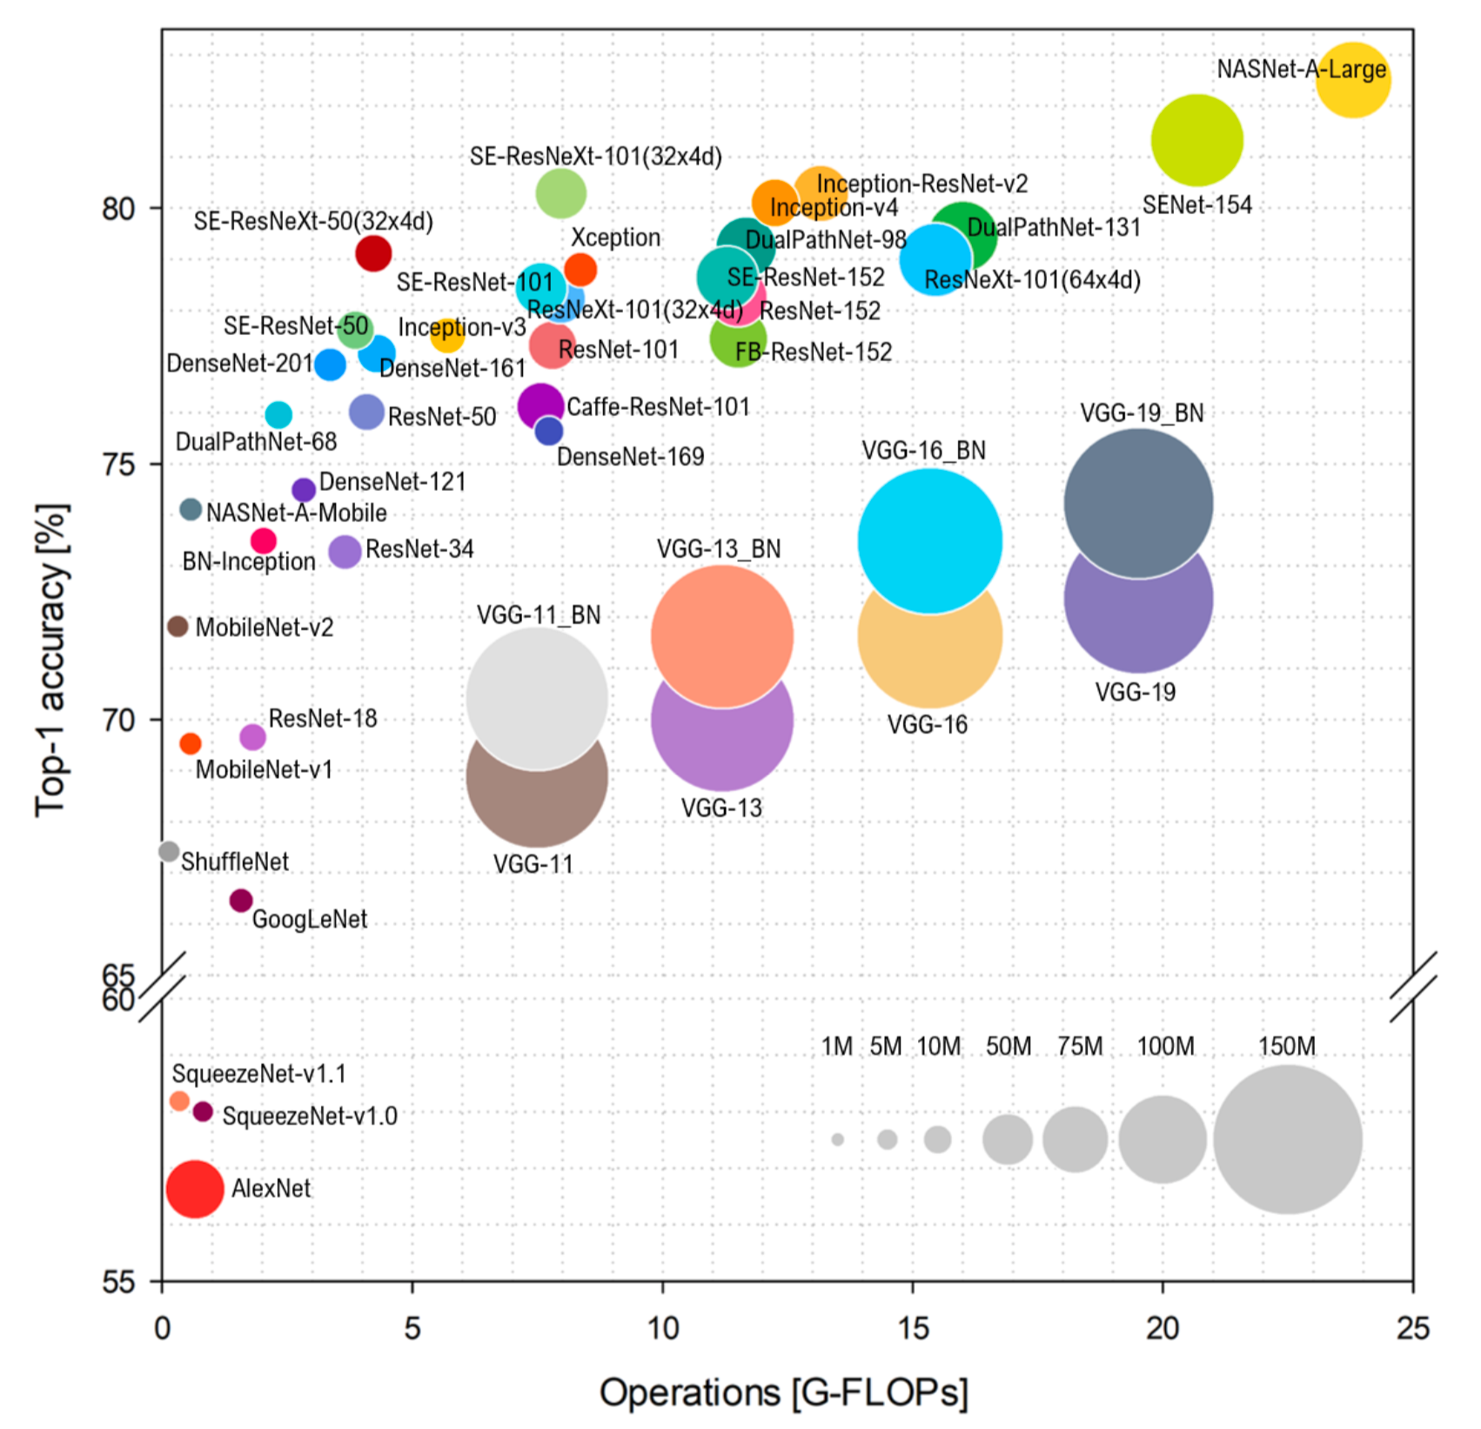
Inference in Deep Learning Models
Benchmark Analysis of Representative Deep Neural Network Architectures
Compute intensive
Less memory intensive than training

Slide 69
Inference in Deep Learning Models
Benchmark Analysis of Representative Deep Neural Network Architectures
TitanXP
Compute intensive
Less memory intensive than training
Latency vs throughput tradeoff determined by batch size and hardware
Increase batch size
Increase throughput ☺
Increase latency ☹

Slide 70
Inference in Deep Learning Models
Benchmark Analysis of Representative Deep Neural Network Architectures
Batch Size. 1 2 4 8 16 32 64
TitanXP
Compute intensive
Less memory intensive than training
Latency vs throughput tradeoff determined by batch size and hardware
Increase batch size
Increase throughput ☺
Increase latency ☹

Slide 71
BERT-Large on a V100 (~$10K)
Results included Mixed precision optimizations!
Numbers obtained from: https://developer.nvidia.com/deep-learning-performance-training-inference

Slide 72
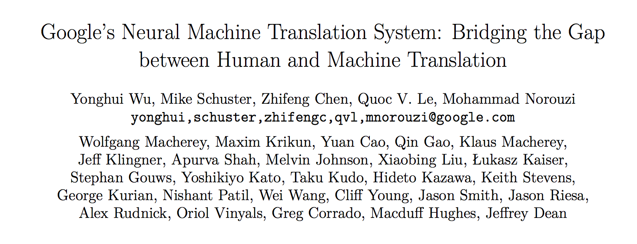
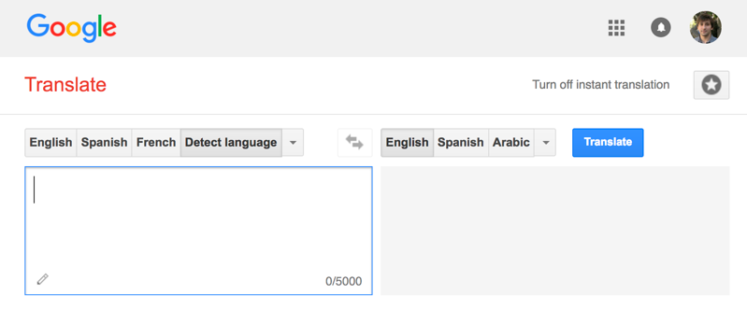
Google Translate
Serving
“If each of the world’s Android phones used the new Google voice search for just three minutes a day, these engineers realized, the company would need twice as many data centers.” – Wired
140 billion words a day¹
Designed New Hardware!
Tensor Processing Unit (TPU)
82,000 GPUs running 24/7
[1] https://www.nytimes.com/2016/12/14/magazine/the-great-ai-awakening.html
Notes:
Model scoring that drove Google to develop new hardware, not training
Mention Paul Barham’s talk

Slide 73
Other Challenges?
Bursty load →
overprovision resources →
expensive
TPU reports 28% utilization of vector units in production
Solutions
statistical multiplexing → hardware not designed for multitenancy
could try to predict arrival process → generally difficult to predict
Versioning and testing models
Prediction pipelines → more on this soon

Slide 74
Query
Inference
Decision
Big Model
Application
Two Approaches
Offline: Pre-Materialize Predictions
Online: Compute Predictions on the fly

Slide 75
Pre-materialized Predictions

Slide 76
Pre-materialized Predictions
Batch Training Framework
All Possible
Queries

Slide 77
Pre-materialized Predictions
Data Management System
Batch Training Framework
(Scoring)
All Possible
Queries

Slide 78
Pre-materialized Predictions
Data Management System
Batch Training Framework
(Scoring)
All Possible
Queries
Standard Data Eng. Tools

Slide 79
Serving Pre-materialized Predictions
Data Management System
Query
Batch Training Framework
(Scoring)
Decision
All Possible
Queries
Application
Low-Latency Serving
Standard Data Eng. Tools

Slide 80
Serving Pre-materialized Predictions
Data Management System
Advantages:
Leverage existing data serving and model training infrastructure
Batch processing improves hardware perf.
Indexing support for complex queries
Find all Pr(“cute”) dresses where price < $20
More predictable performance
Query
Batch Training Framework
(Scoring)
Decision
All Possible
Queries
Application
Low-Latency Serving

Slide 81
Serving Pre-materialized Predictions
Data Management System
Problems:
Requires full set of queries ahead of time
Small and bounded input domain
Requires substantial computation and space
Example: scoring all content for all customers!
Costly update → rescore everything!
Query
Batch Training Framework
(Scoring)
Decision
All Possible
Queries
Application
Low-Latency Serving

Slide 82
Query
Inference
Decision
Big Model
Application
Two Approaches
Offline: Pre-Materialize Predictions
Online: Compute Predictions on the fly

Slide 83
Query
Inference
Decision
Big Model
Application
Two Approaches
Offline: Pre-Materialize Predictions
Online: Compute Predictions on the fly

Slide 84
Prediction Services
Specialized systems which render predictions at query time.

Slide 85
Architecture of a Prediction Service
Edge
Cloud
Application Services
Data
Services
Client
Client
Client
Client
2
3
Client
1
4
Client
Prediction
Service
Load Balancer
12
Cache
Prediction
Service
9
5
Prediction
Service
Cache
11
8
Prediction
Service
10
Prediction
Service
6
Feedback
7

Slide 86
Online: Compute Predictions at Query Time
Examples
Signals processing: speech recognition & image tagging
Ad-targeting based on search terms, available ads, user features
Advantages
Compute only necessary queries
Enables models to be changed rapidly (e.g., bandit exploration)
Queries do not need to be from small ground set
Disadvantages
Increases complexity and computation overhead of serving system
Requires low and predictable latency from models

Slide 87
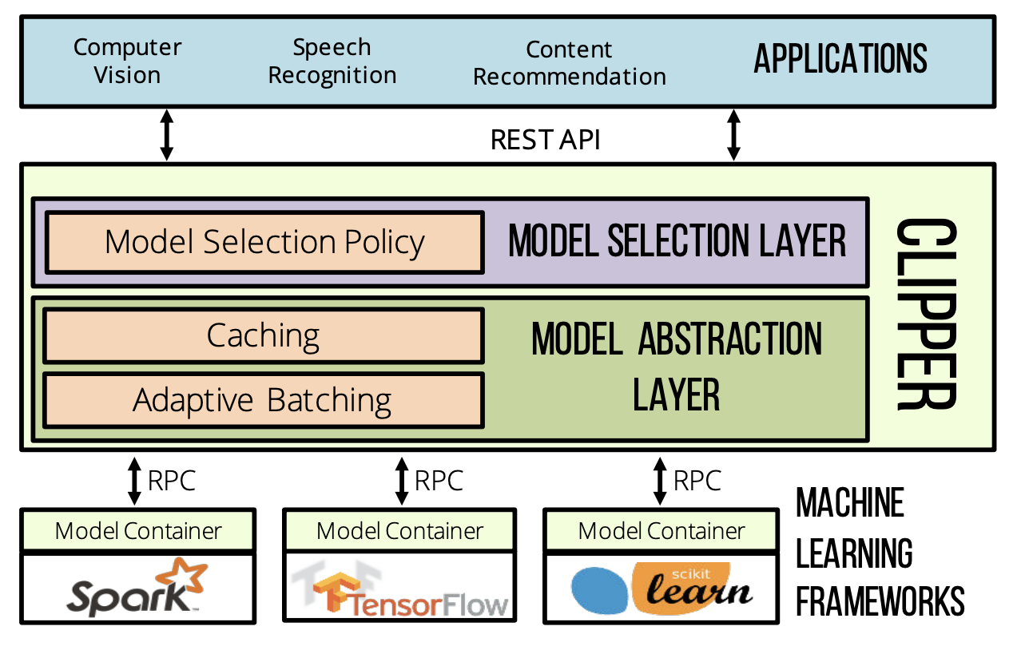
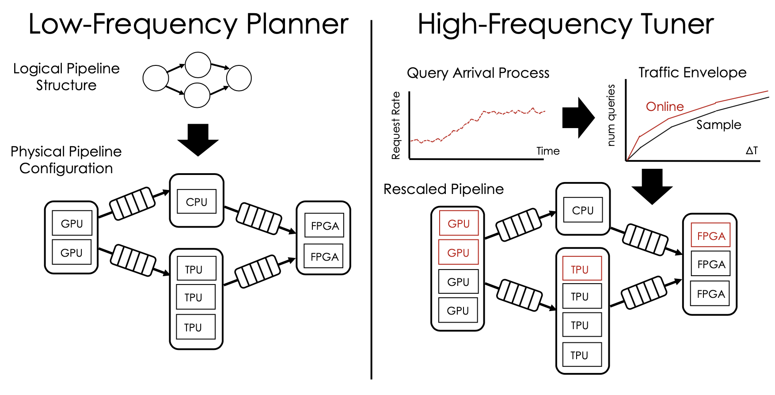
Active Area of Research in my Group
Clipper Prediction Serving System
[NSDI’17]
InferLine Pipeline Provisioning System
[Under review]

Slide 88
Prediction Serving → Hardware
Inference requires less memory → focus on compute
Greater emphasis on latency instead of throughput
Focus on small batch inference (batch size = 1)
Opportunity to exploit pipeline parallelism
Need high availability → esp. in mission critical settings
Often runs multiple concurrent prediction tasks
Cloud → Multitenancy → Performance isolation
Edge → supporting multiple data streams
Tolerate model compression and quantization
As low as 4-bit activations and weights
Bursty load
Statistical multiplexing
Use inference hardware for background training?

Slide 89
Machine Learning Lifecycle
Security?

Slide 90
Machine Learning Lifecycle
Security?

Slide 91
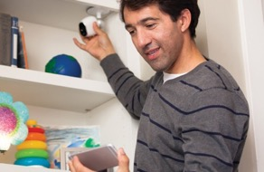
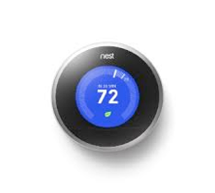
Protect the data, the model, and the query
High-Value Data is Sensitive
Medical Info.
Home video
Finance
Models capture value in data
Core Asset
“Contain” the data
Data
Biggest opportunity for hardware in ML.
Queries can be as sensitive as the data

Slide 92
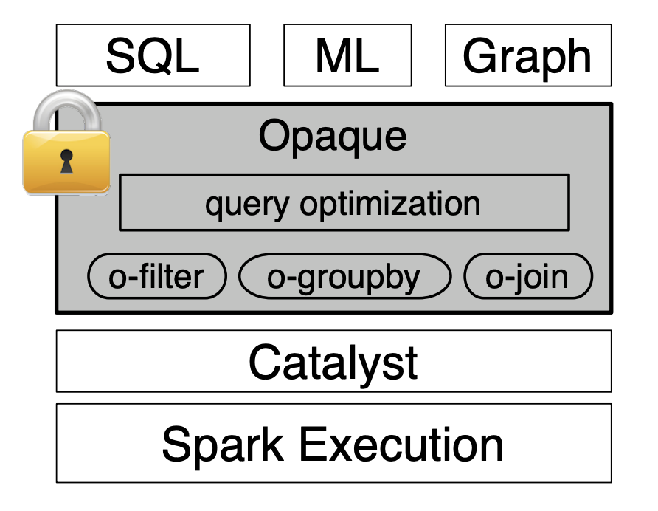
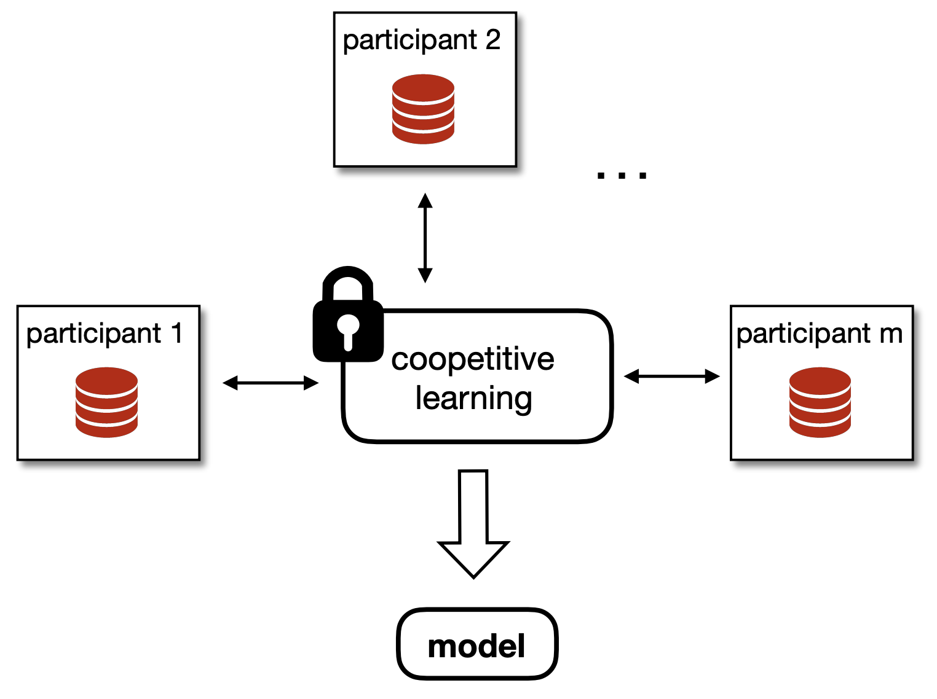
Our recent work in secure ML
Opaque
Helen
Coopetitive Learning Using Cryptographic Primitives
Oblivious Spark over SGX
[NSDI’17]
[S&P’19]

Slide 93
Security and Hardware
Improved Access to Data
User willing to share data with models but not companies (people)
Differential Privacy can increase data sharing incentives
Better isolation of co-tenant models on hardware accelerators
Coopetitive Learning: Secure multiparty computation for ML
Example: Competing banks collaborate to construct a shared fraud model without sharing data.
Models have access to more sensitive inputs
Example: Alexa could see where you are when asking to turn on a light.

Slide 94
Conclusion
History: AI and Computer Systems have Co-evolved
Feedback Cycle: Hardware, Abstractions, and Data
ML is many Applications: Machine Learning Lifecycle
Model Development: Exploration
Training: Scale and Composition
Inference: Cloud – Edge Spectrum
Security: Opportunity for hardware innovation in AI
Thank you!

